Slide 1
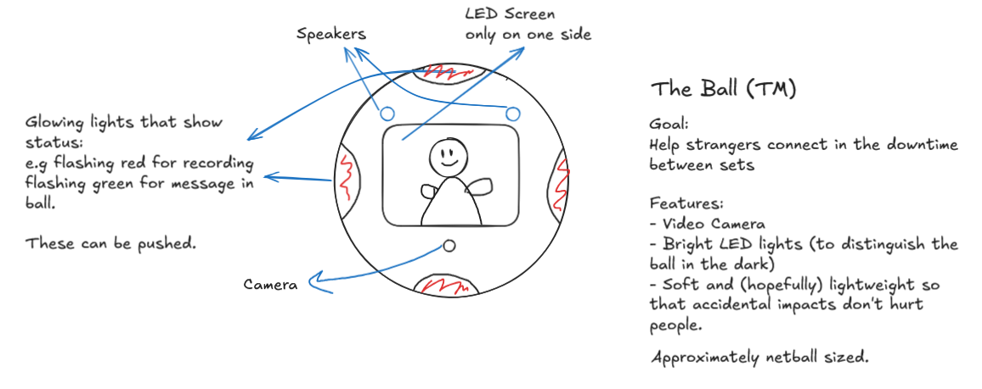


Slide 2
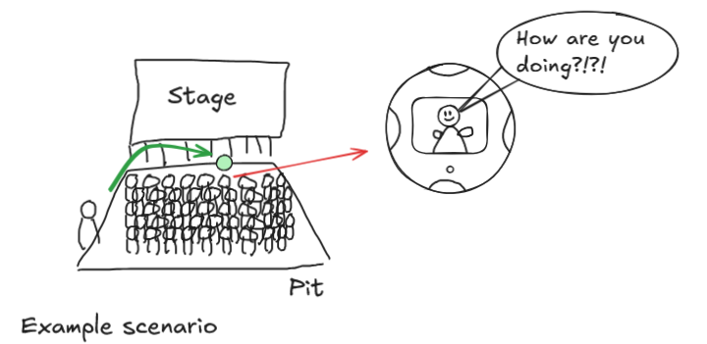
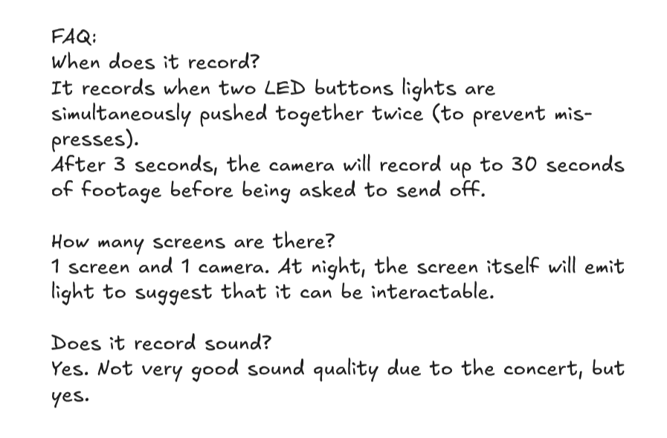

Slide 3
Excalidraw link
https://excalidraw.com/#json=yRm-ePun_F0rPcbte6ISW,0mxkkzUltBUaBDYzDqlSGA

Slide 4
